Slide 1
Power Consumption Prediction
By Pritam Das

Slide 2
Index
Title
Slide No
Objective
Data Source
Technologies used
Methodology
Model performance
Streamlit app
Conclusion
Future scope
3
4
5
6
7
8
9
10

Slide 3
Objective
Develop a machine learning model to accurately predict power consumption in Zone 3 by analyzing historical usage patterns, weather conditions, and emission-related factors.
Identify key temporal and environmental patterns influencing energy demand to enhance forecasting accuracy.
Support energy management authorities in optimizing grid performance, reducing operational costs, and promoting sustainable energy use through data-driven insights.
Enable informed decision-making for efficient resource allocation and strategic planning for future zone expansions.

Slide 4
Data Source
Dataset:
powerconsumption.csv
Contains power consumption records like:
Datetime: Timestamp of each recorded observation
Temperature: Ambient temperature in Celsius
Humidity: Atmospheric moisture level
WindSpeed: Wind velocity in kilometers per hour
GeneralDiffuseFlows: Measurement of overall emission gas diffusion into the broader atmosphere
DiffuseFlows: Measurement of localized emission gas diffusion
PowerConsumption_Zone1: Energy consumption (kWh) in Zone 1
PowerConsumption_Zone2: Energy consumption (kWh) in Zone 2
PowerConsumption_Zone3: Energy consumption (kWh) in Zone 3

Slide 5
Technologies used
Python: Data preprocessing, model experimentation
Jupyter Notebook: For model development (model.ipynb)
Machine Learning: SARIMAX for forecasting power consumption at zone 3.
Power BI: Data visualization and interactive dashboard (power_consumption_dashboard.pbix)
Libraries Used: pandas, numpy, scikit-learn, matplotlib, seaborn, statsmodels, cloudpickle, dill

Slide 6
Methodology
Data Preparation
Loaded powerconsumption.csv
Set datetime as index.
Removed duplicate and null values.
Data Preparation
Correlation heatmap for analyzing the factors affecting power consumption at zone 3
Lineplot of power consumption in different zones at different datetime
Seasonal decompose for finding seasonality
Preprocessing
Adfullar test for checking data is stationary or not
Standardized features with StandardScaler
Modelling and Evaluation
Split dataset by half and trained SARIMAX model
Evaluated with Mean Absolute Error, Root Mean Squared Error and R2 Score
Trained the final model with full dataset and saved the pipeline
Streamlit app interface
Built an interactive app interface using streamlit.
Takes data of power consumption from January 1 to December 30.
Forecast average, minimum and maximum power consumption and plots it.

Slide 7
Model Performance
Mean Absolute Error: 8797.42
Root Mean Absolute Error: 9603.48
R2 score: -1.01

Slide 8
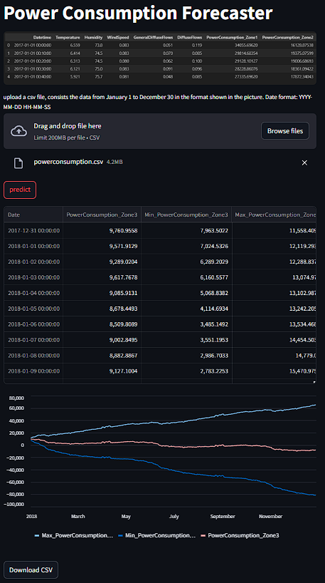

Streamlit App
Project link: pritam2005das/Power-Consumption-Forecaster
Notes:
As the model.pkl is too big, streamlit cloud isn’t supporting deployment.

Slide 9
Conclusion
Performed data preprocessing and time-based resampling to prepare daily power consumption data for Zone 3.
Developed and trained a SARIMAX forecasting model within a machine learning pipeline to predict future power usage based on historical trends.
Implemented a Streamlit web application that enables users to upload consumption data, visualize forecasts with confidence intervals, and download predicted results.
Created an interactive Power BI dashboard for visual analysis of consumption patterns and seasonal variations.
The project demonstrates how time series forecasting combined with interactive visualization tools can support efficient energy planning, demand management, and sustainable grid operations.

Slide 10
Future Scope
Model Enhancement: Incorporate deep learning architectures such as LSTM or GRU networks to better capture long-term temporal dependencies in power consumption trends.
Expanded Data Integration: Include additional external factors like real-time weather forecasts, industrial load data, and economic indicators to further improve prediction accuracy.
Real-Time Forecasting: Deploy the model in a live monitoring system to provide continuous, real-time energy demand forecasts and alerts for grid operators.
Zone-Wise Scalability: Extend the current model to other zones to create a unified, multi-zone energy forecasting system.
Renewable Energy Optimization: Integrate solar and wind energy data to analyse potential renewable energy contributions and optimize sustainable energy distribution.
Interactive Dashboards: Enhance the Power BI dashboard with predictive analytics and “what-if” scenario simulations for better decision-making by energy authorities.

Slide 11

Feedback
Please give me feedback of my project.
Your feedback will encourage and motivate me.
Click here for feedback form

Slide 12
Thank you..

